Slide 1
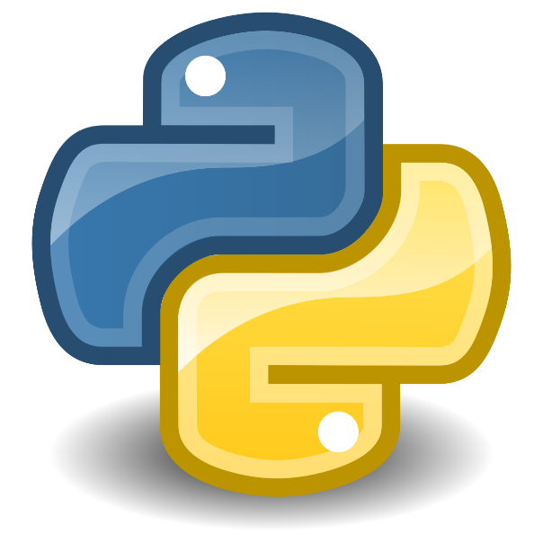


Introduction to Django framework
Kusal Bista

Slide 2
Meet Django
High-level Python web framework.
Encourages rapid development.
Clean, pragmatic design.
Free and open source.

Slide 3

Ridiculously fast.
Django was designed to help developers take applications from concept to completion as quickly as possible.

Slide 4

Fully loaded
Django includes dozens of extras you can use to handle common web development tasks.

Slide 5
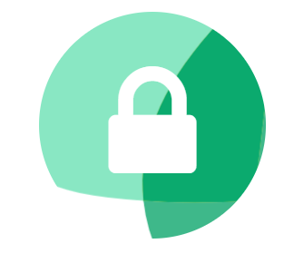
Reassuringly secure.
Django takes security seriously.
Its user authentication system provides a secure way to manage user accounts and passwords.
Helps developers avoid many common security mistakes.
Like:
SQL injections
Cross-site scripting
Cross-site request forgery (CSRF)
Clickjacking.

Slide 6
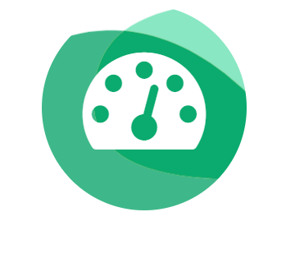
Exceedingly scalable
Some of the busiest sites on the planet use Django.
It’s ability to quickly and flexibly scale to meet the heaviest traffic demands.

Slide 7
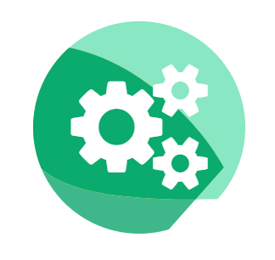
Incredibly versatile.
Companies, organizations and governments have used Django to build all sorts of things — from content management systems to social networks to scientific computing platforms.

Slide 8
Why Django?
Simple syntax.
MVC (Model-View-Controller) core architecture.
An ORM (Object Relational Mapper).
HTTP libraries.
Middleware support.
A Python unit test framework.
Cross-platform.

Slide 9
What you can do with Django?
Built-in custom CRM systems for internal data.
B2B CRM systems for handling communication between businesses.
Platforms that facilitate communication between two parties, such as a business and a consumer;
High-load booking engines or shopping platforms;
Android and iOS mobile apps that support web applications;
An emailing system for sending notifications to users.
Data-analysis tools.
Admin dashboards.

Slide 10
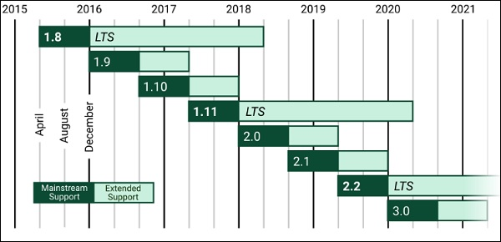
Stable releases

Slide 11
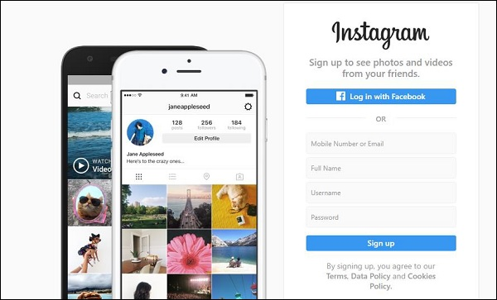
Who’s Using Django?
Instagram (https://www.instagram.com/)

Slide 12
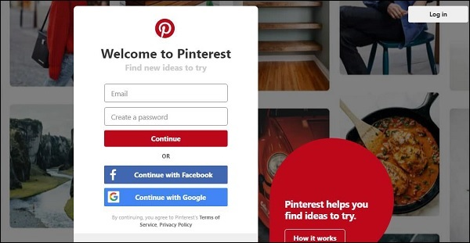
Pinterest (https://www.pinterest.com/)

Slide 13
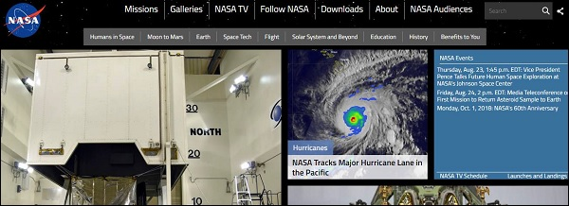
NASA (https://www.nasa.gov/)

Slide 14
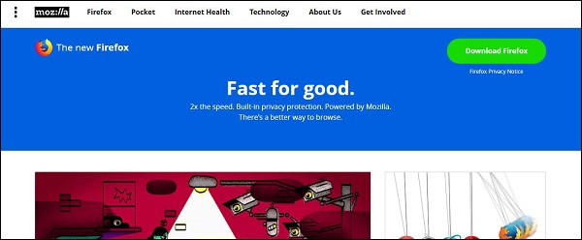
Mozilla Firefox

Slide 15
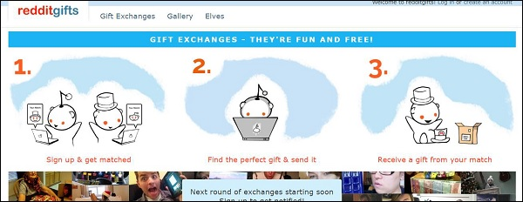
Reddit

Slide 16
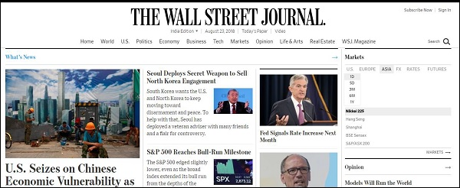
The Washington Post

Slide 17
Django Project MVT Structure
MVT stands for Model-View-Template.
It is software design pattern.
It is a data access layer which handles the data.
Model: It manages the data and is represented by a database. A model is basically a database table.
View: It receives HTTP requests and sends HTTP responses. A view interacts with a model and template to complete a response.
Template: It is basically the front-end layer and the dynamic HTML component of a Django application.

Slide 18
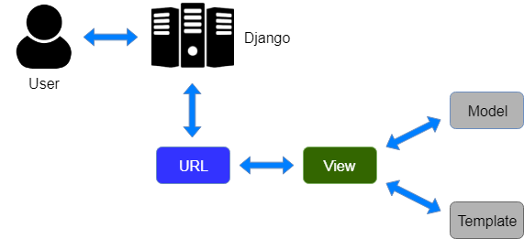
MVT structure

Slide 19
Requirements.
PyCharm professional: The Python IDE for Professional Developers.
Download link: https://www.jetbrains.com/pycharm/download
(Use student email to register and get free application.)
Reference video for installation: https://youtu.be/23PX1X1FAqw
Python 3.6:
Download link: https://www.python.org/downloads/release/python-368/
Reference video for installation: https://youtu.be/3lGhtIqT0Tk
Reference document for installation: https://realpython.com/installing-python/
GitHub: If you are not yet registered in GitHub, do so by going to https://github.com/

